Slide 1
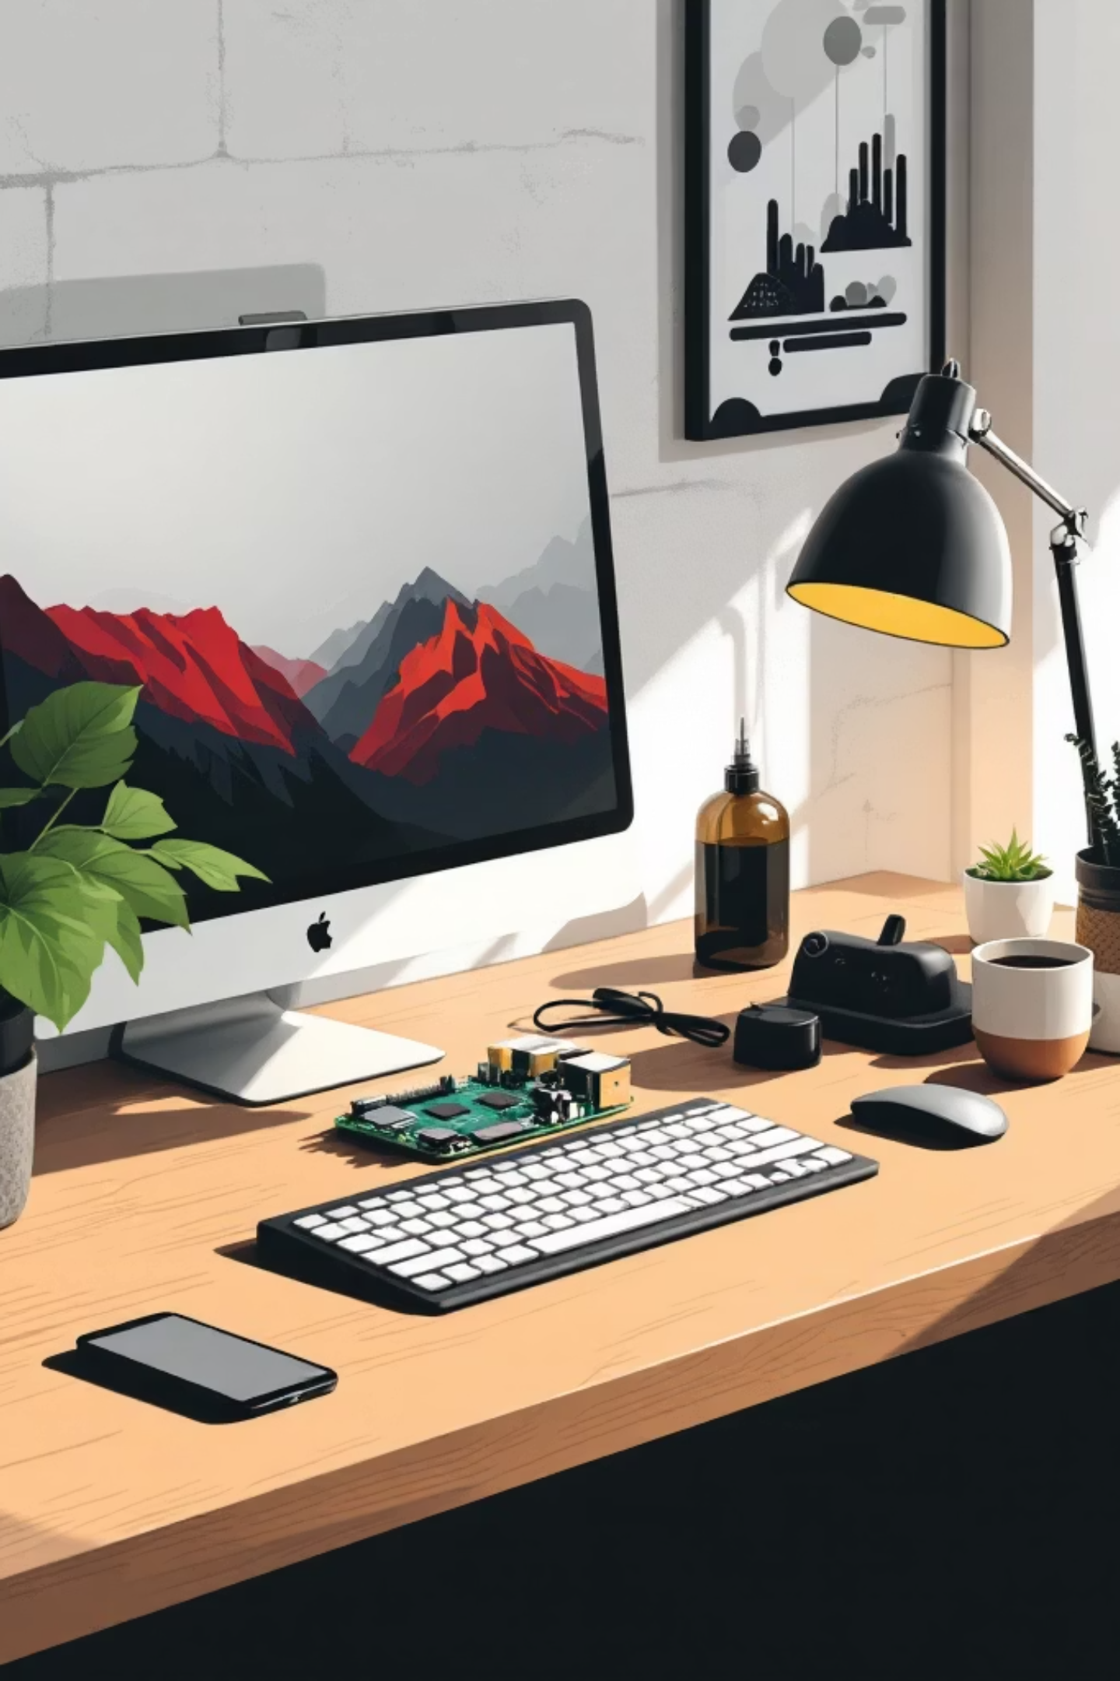
Unveiling the Raspberry Pi: Your Gateway to Computing
Discover how this credit-card-sized computer is revolutionizing technology education, DIY projects, and innovation worldwide.

Slide 2
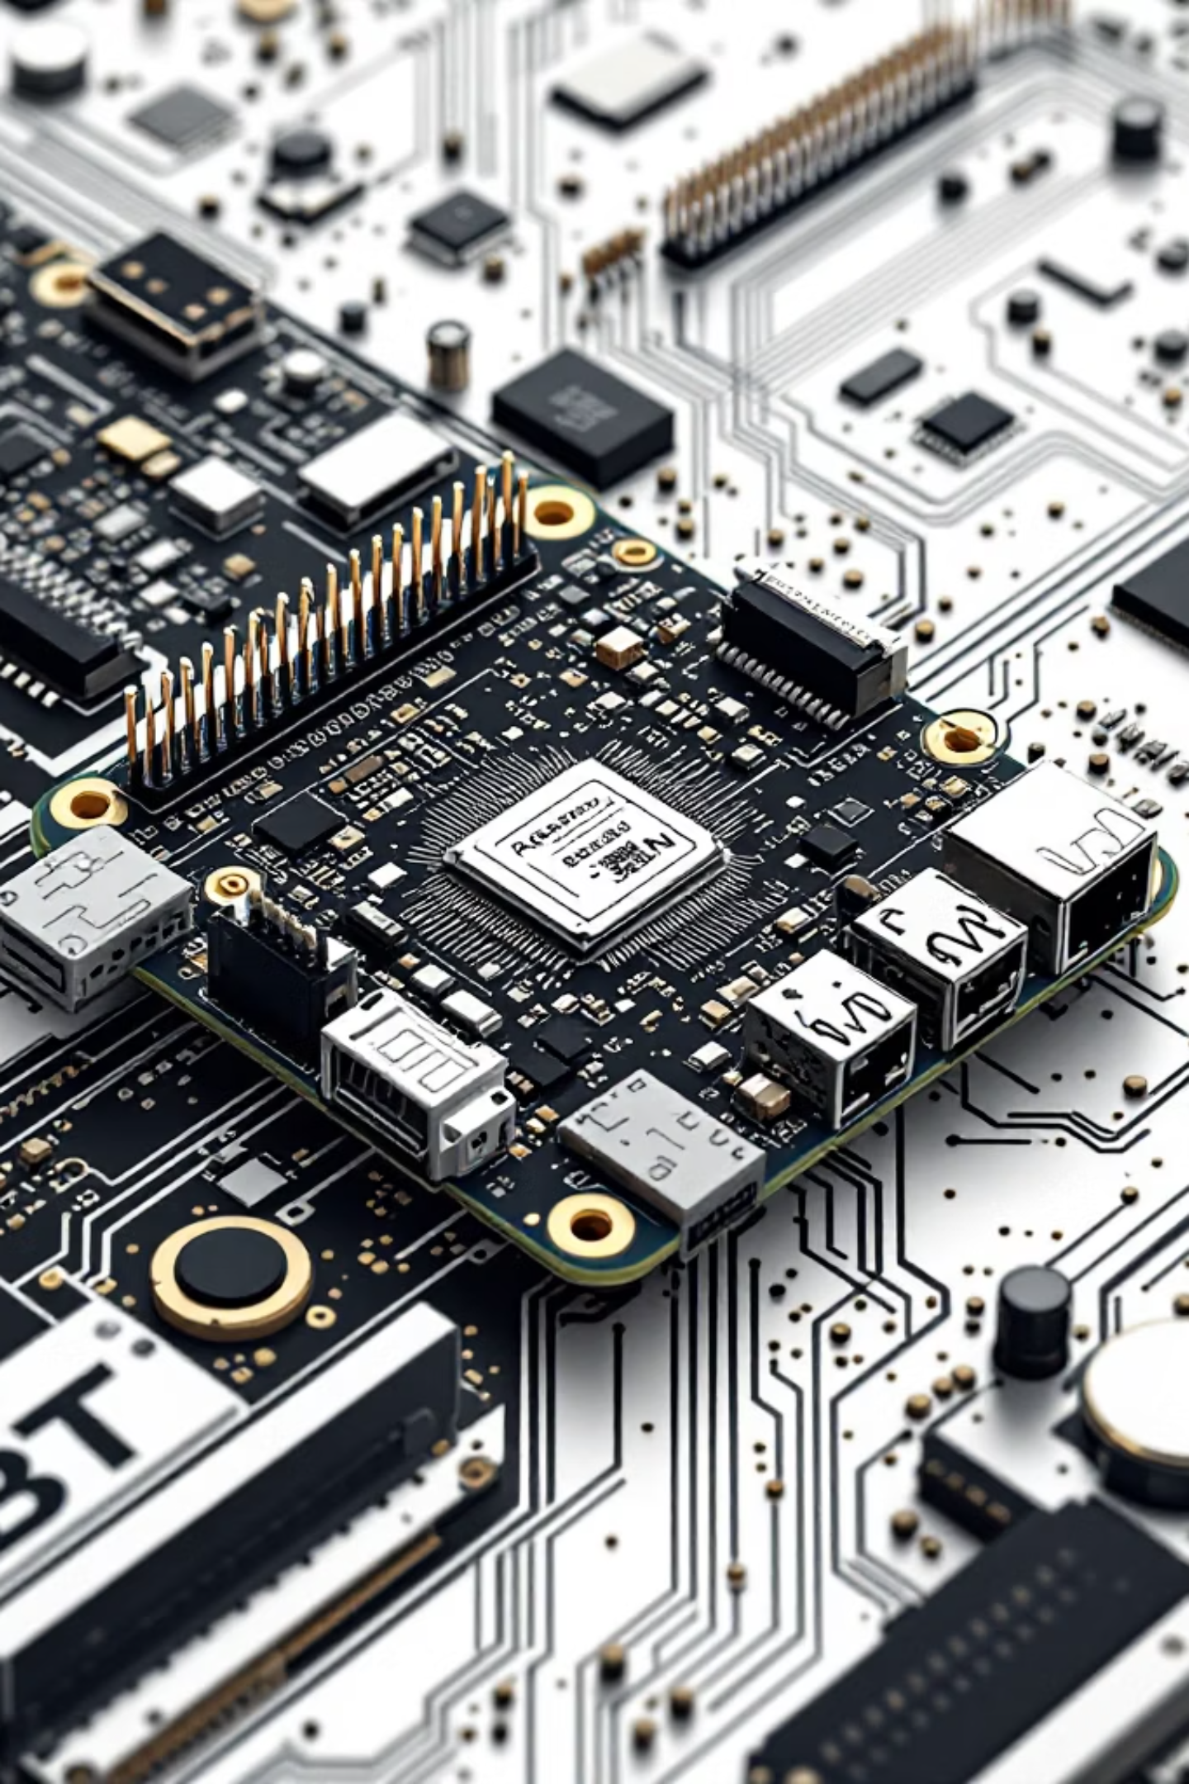

What is a Raspberry Pi? A Powerful, Pint-Sized Computer
The Raspberry Pi is a series of small, affordable single-board computers developed by the Raspberry Pi Foundation. Despite its compact size—measuring just 85.60mm × 56.50mm—these devices pack impressive computing power, making them perfect for learning programming, building projects, and exploring technology.
Processor Power
Quad-core CPUs running at speeds up to 1.8GHz
Memory Options
From 1GB to 8GB RAM depending on model
Connectivity
Multiple USB ports, HDMI, Ethernet, and GPIO pins
Affordable Price
Starting at just $5 for the smallest model

Slide 3
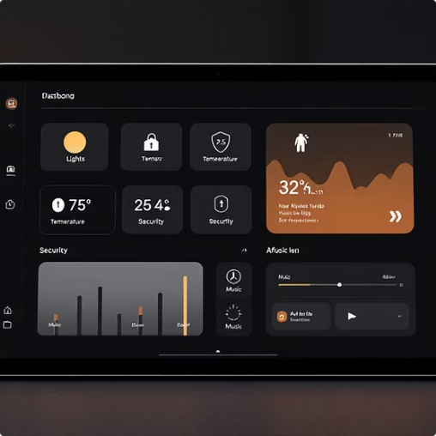

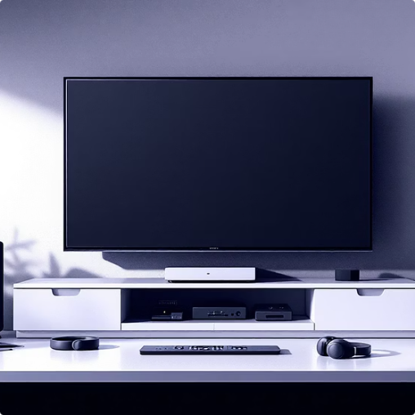
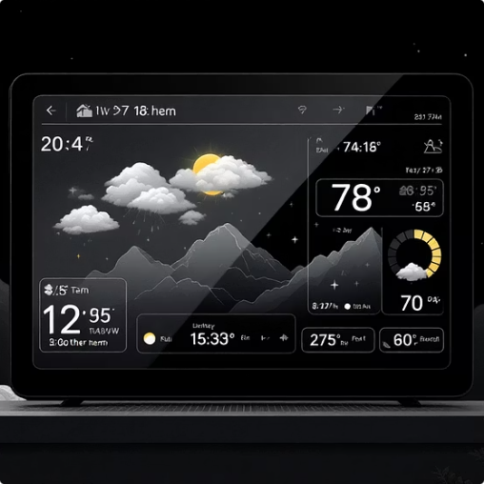
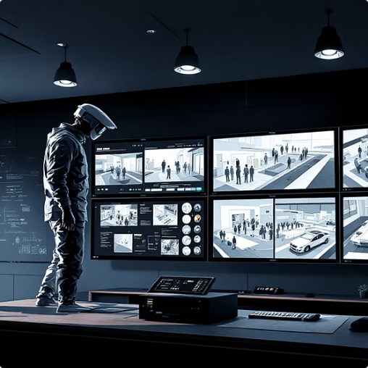
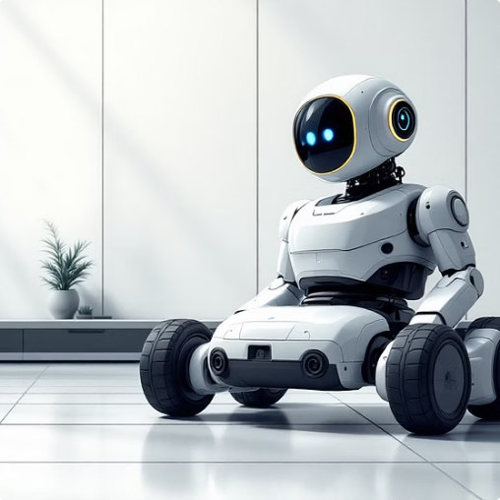
Unleashing Creativity: Projects for Every Skill Level
From simple beginner projects to complex multi-year endeavors, the Raspberry Pi ecosystem offers endless possibilities for creators of all experience levels.
Home Automation
Retro Gaming Console
Media Center
Weather Station
Build your own smart home system to control lights, temperature, and security with voice commands or a mobile app.
Create a retro arcade machine with thousands of classic games from the 80s, 90s, and 2000s.
Transform your Pi into a streaming box for movies, music, and shows from your personal library or online services.
Monitor temperature, humidity, pressure, and rainfall in your area with sensors and display data on a web dashboard.
Security Camera
Robotics Platform
Set up motion-activated surveillance with night vision and cloud storage for your home or workspace.
Control motors, servos, and sensors to build autonomous robots that navigate, avoid obstacles, and complete tasks.

Slide 4
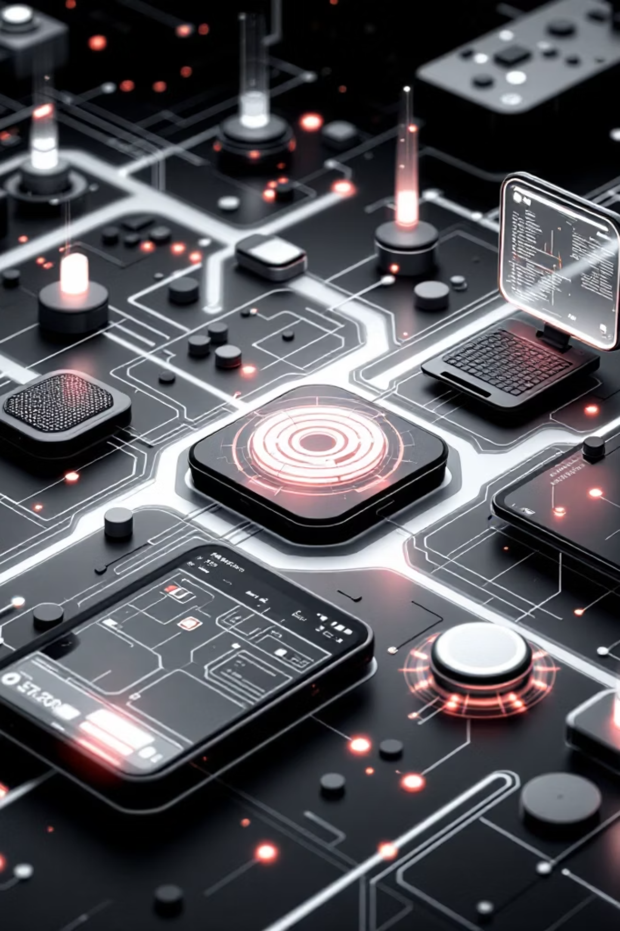
Beyond the Basics: Advanced Applications and IoT
Internet of Things (IoT)
Connect sensors and devices to collect data, automate processes, and monitor systems remotely. Perfect for industrial monitoring, agriculture, and environmental sensing.
Edge Computing
Process data locally on the Pi instead of sending it to the cloud, reducing latency and bandwidth costs while maintaining privacy and security.
Machine Learning
Run AI models for image recognition, natural language processing, and predictive analytics directly on the device using TensorFlow Lite and other frameworks.
Network Services
Host your own web server, VPN, ad blocker, or file server, giving you complete control over your network infrastructure without recurring fees.

Slide 5
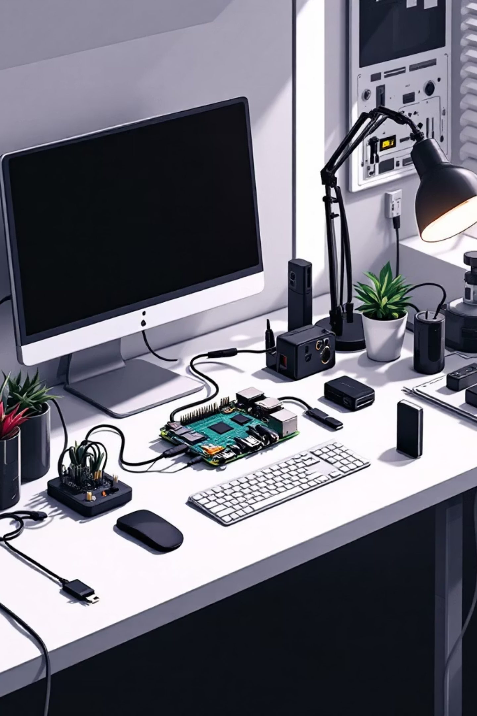
Getting Started: Essential Tools and First Steps
Ready to dive into the world of Raspberry Pi? Here's everything you need to begin your journey from unboxing to your first project.
Acquire Hardware
Start with a Raspberry Pi 4 or 400, microSD card (16GB+), power supply, HDMI cable, and optionally a case. Total cost: $55-$90.
Install OS
Download Raspberry Pi Imager, flash Raspberry Pi OS onto your microSD card, and boot up your device.
Learn Basics
Explore Python programming, Linux commands, and GPIO pin control through official tutorials and beginner projects.
Build Projects
Start with simple LED blinking, move to sensors and displays, then tackle more complex multi-component projects.

Slide 6

The Future of Pi: Innovations and Community Impact
40M+
200+
100%
Units Sold
Projects
Open Source
Over 40 million Raspberry Pis shipped worldwide since 2012
Official tutorials and community projects available online
Software, documentation, and community support are free
The Raspberry Pi Foundation continues to innovate with new models like the Pi 5, while maintaining backward compatibility. The community-driven ecosystem grows daily, with users sharing projects, tutorials, and modifications online.
From classrooms to research labs, the Raspberry Pi is democratizing access to computing power, enabling anyone to learn, create, and innovate regardless of budget or location. The future promises even more powerful hardware, better software support, and expanded educational initiatives.

